Slide 1
Machine Learning II
Lecture 8 – Fine tune parameters and hyper parameters

Slide 2
Introduction
How to initialize parameters and hyper parameters?
Weight initialization
Weight decay and momentum
Cross-entropy
Adam optimization

Slide 3
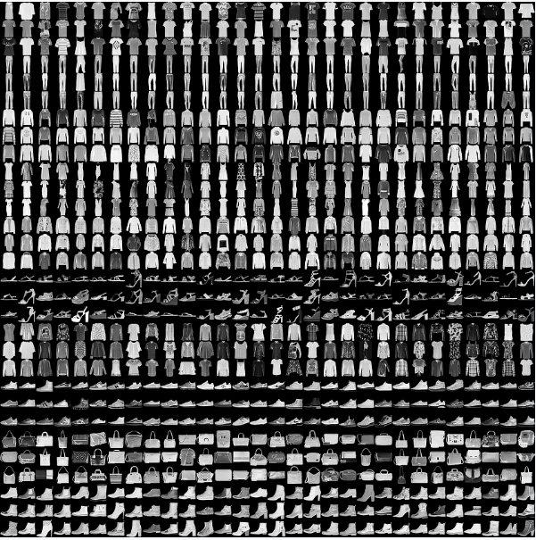
Example
Fashion MNIST dataset contains 70,000 grayscale images in 10 categories. The images show individual articles of clothing at low resolution (28 by 28 pixels), as seen here:

Slide 4
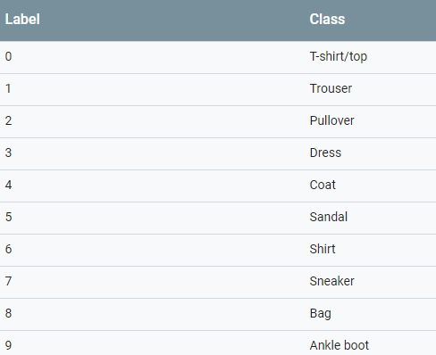
Loading data
The dataset can be loaded as below:
# Load dataset
fashion_mnist = keras.datasets.fashion_mnist
(train_images, train_labels), (test_images, test_labels) = fashion_mnist.load_data()
The classes are shown in following table

Slide 5
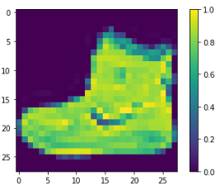
Loading data
Each image is mapped to a single label. Since the class names are not included with the dataset, store them here to use later when plotting the images
class_names = ['T-shirt/top', 'Trouser', 'Pullover', 'Dress', 'Coat', 'Sandal', 'Shirt', 'Sneaker', 'Bag', 'Ankle boot']
We can draw the images in the dataset:
plt.figure()
plt.imshow(train_images[0])
plt.colorbar()
plt.grid(False)
plt.show()

Slide 6

Pre-processing
Normalize the data as we did before.
train_images = train_images / 255.0
test_images = test_images / 255.0
Draw dataset:
plt.figure(figsize=(10,10))
for i in range(25):
plt.subplot(5,5,i+1)
plt.xticks([])
plt.yticks([])
plt.grid(False)
plt.imshow(train_images[i], cmap=plt.cm.binary)
plt.xlabel(class_names[train_labels[i]])
plt.show()

Slide 7
Model design
num_pixels = train_images.shape[1] * train_images.shape[2] #28*28 = 784
X_train = train_images.reshape(train_images.shape[0], num_pixels)
X_test = test_images.reshape(test_images.shape[0], num_pixels)
# normalize inputs from 0-255 to 0-1
X_train = X_train / 255
X_test = X_test / 255
Y_test = test_labels
from keras.utils import np_utils
# one hot encode outputs
y_train = np_utils.to_categorical(train_labels )
y_test = np_utils.to_categorical(test_labels )
from tensorflow.keras.models import Sequential
from tensorflow.keras.layers import Dense
from tensorflow.keras import optimizers
hidden_nodes = 128
num_classes = y_test.shape[1]
def baseline_model():
# create model
model = Sequential()
model.add(Dense(num_pixels, input_dim= num_pixels, activation='relu'))
model.add(Dense(hidden_nodes, activation='relu'))
model.add(Dense(num_classes, activation='softmax'))
sgd = optimizers.SGD(lr=0.01)
# Compile model
model.compile(loss='mean_squared_error', optimizer=sgd, metrics=['accuracy'])
return model

Slide 8
Train and test
model = baseline_model()
# Fit the model
nn_simple = model.fit(X_train, y_train, validation_split=0.2, epochs=80, batch_size=200)
# Final evaluation of the model
scores = model.evaluate(X_test, y_test)
print("Accuracy: %.2f%%" % (scores[1]*100))
Accuracy: 24.30%
Possible Solution- We didn’t pre-defined weights. Let’s do that but how??

Slide 9
Parameters- Weight initialization
Issues of choosing wrong weight:
Vanishing gradients: In case of deep networks, for any activation function, abs(dW) will get smaller and smaller as we go backwards with every layer during back propagation. The earlier layers are the slowest to train in such a case.
Exploding gradients : This is the exact opposite of vanishing gradients. Consider you have non-negative and large weights and small activations (as can be the case for sigmoid(z)). When these weights are multiplied along the layers, they cause a large change in the cost. This may result in oscillating around the minima or even overshooting the optimum again and again and the model will never learn.

Slide 10

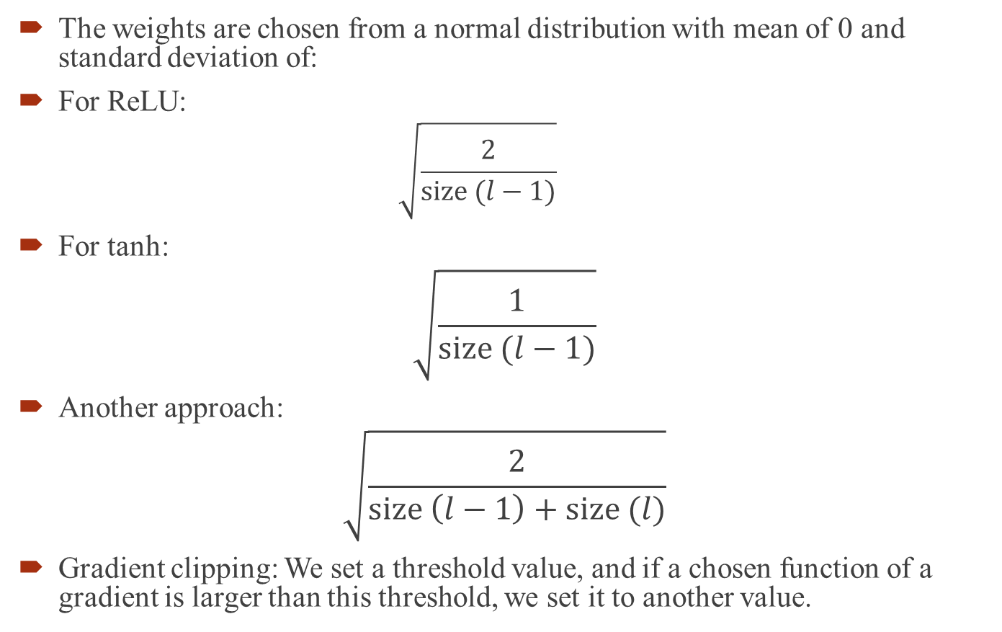
Best Weights
The weights are chosen from a normal distribution with mean of 0 and standard deviation of:
For ReLU:
$$\sqrt{\frac{2}{size (l−1)}}$$
For tanh:
$$\sqrt{\frac{1}{size (l−1)}}$$
Another approach:
$$\sqrt{\frac{2}{size \left(l−1\right)+size (l)}}$$
Gradient clipping: We set a threshold value, and if a chosen function of a gradient is larger than this threshold, we set it to another value.
$l$= #neuron in the layer

Slide 11



New weight initialization
If we initialize weights, the weights will be assigned as mean=0 and std= ...
$$\sqrt{\frac{2}{784}}$$
$$\sqrt{\frac{2}{128}}$$
$$\sqrt{\frac{2}{128}}$$
def baseline_model():
# create model
model = Sequential()
model.add(Dense(hidden_nodes, input_dim= num_pixels, kernel_initializer= 'normal' ,activation='relu'))
model.add(Dense(128, kernel_initializer= 'normal', activation='relu'))
model.add(Dense(num_classes, kernel_initializer='normal', activation='softmax'))
sgd = optimizers.SGD(lr=0.01)
# Compile model
model.compile(loss='mean_squared_error', optimizer=sgd, metrics=['accuracy'])
return model
Accuracy: 32.97%

Slide 12

Hyper parameters- Weight Decay
As we discussed last week, we can use L2 regularization to prevent from overfitting where after each update, the weights are multiplied by a factor slightly less than 1.
$$w→w−η\left(1−\frac{ηλ}{n}\right)w−η\frac{∂C_{0}}{∂w}$$
sgd = optimizers.SGD(lr=0.01, decay=0.01)

Slide 13
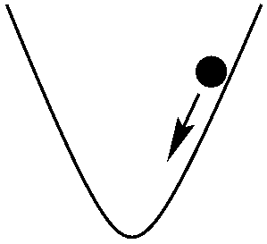
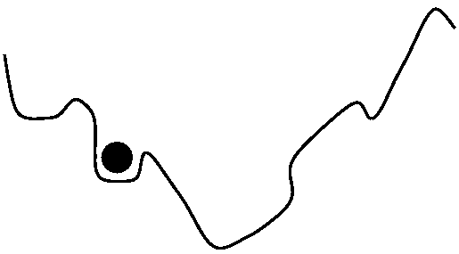
Momentum
In optimization problem we want to find the global minimum
However, in real world this is what we end up with.
Momentum can jump these local minimums which is a value between 0 and 1 that increases the size of the steps taken towards the minimum by trying to jump from a local minima.

Slide 14
Momentum
If the momentum term is large then the learning rate should be kept smaller.
A large value of momentum also means that the convergence will happen fast.
If both the momentum and learning rate are kept at large values, then you might skip the minimum with a huge step.
A small value of momentum cannot reliably avoid local minima, and can also slow down the training of the system.
Mathematically, we can call it some type of weighted average.
We are getting weighting average of all the steps.

Slide 15

Momentum
$V_{dw}=βV_{dw}+\left(1−β\right)dw$
$W=W−αV_{dw}$
sgd = optimizers.SGD(lr=0.01, momentum=0.9)
Accuracy: 35.20%

Slide 16
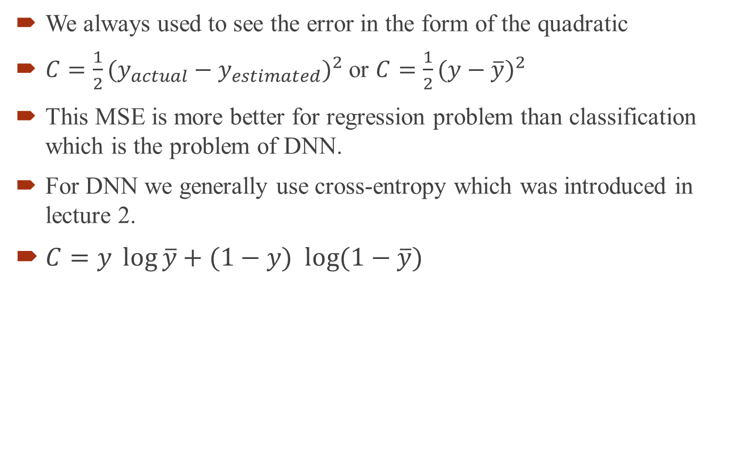
Cross entropy
We always used to see the error in the form of the quadratic
$C=\frac{1}{2}(y_{actual}−y_{estimated})^{2}$ or $C=\frac{1}{2}(y−\overline{y})^{2}$
This MSE is more better for regression problem than classification which is the problem of DNN.
For DNN we generally use cross-entropy which was introduced in lecture 2.
$C=y \log{\overline{y}}+(1−y) \log{(1−\overline{y})}$
model.compile(loss='categorical_crossentropy', optimizer=sgd, metrics=['accuracy'])
Accuracy: 48.87%

Slide 17
Adam optimizer
The Adam (ADAptive Moment) optimization algorithm is an extension to stochastic gradient descent that has recently seen broader adoption for deep learning applications in computer vision and natural language processing.- 2015
The main difference between adam and GD is that the learning rate in adam is not a fixed number and is separately updated for each parameter.
It was a modification of two other algorithms that we don’t cover here:
Adaptive Gradient Algorithm (AdaGrad): that maintains a per-parameter learning rate that improves performance on problems with sparse gradients
Root Mean Square Propagation (RMSProp): that also maintains per-parameter learning rates that are adapted based on the average of recent magnitudes of the gradients for the weight

Slide 18
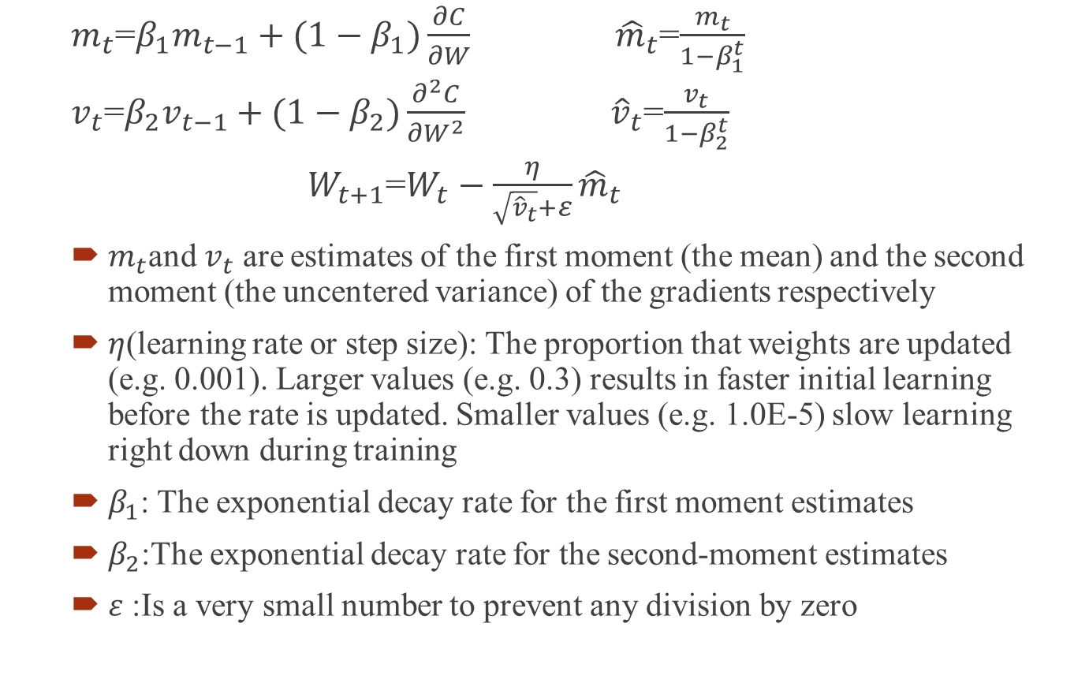
Adam optimizer
$m_{t}$=$β_{1}m_{t−1}+(1−β_{1})\frac{∂C}{∂W}$ ${\hat{m}}_{t}$=$\frac{m_{t}}{1−β_{1}^{t}}$
$v_{t}$=$β_{2}v_{t−1}+(1−β_{2})\frac{∂^{2}C}{∂W^{2}}$ ${\hat{v}}_{t}$=$\frac{v_{t}}{1−β_{2}^{t}}$
$W_{t+1}$=$W_{t}−\frac{η}{\sqrt{{\hat{v}}_{t}}+ε}{\hat{m}}_{t}$
$m_{t}$and $v_{t}$ are estimates of the first moment (the mean) and the second moment (the uncentered variance) of the gradients respectively
$η$(learning rate or step size): The proportion that weights are updated (e.g. 0.001). Larger values (e.g. 0.3) results in faster initial learning before the rate is updated. Smaller values (e.g. 1.0E-5) slow learning right down during training
$β_{1}$: The exponential decay rate for the first moment estimates
$β_{2}$:The exponential decay rate for the second-moment estimates
$ε$ :Is a very small number to prevent any division by zero

Slide 19
Adam optimizer
Pros:
Straightforward to implement.
Computationally efficient.
Little memory requirements.
Well suited for problems that are large in terms of data and/or parameters.
Appropriate for non-stationary objectives.
Appropriate for problems with very noisy/or sparse gradients.
Hyper-parameters have intuitive interpretation and typically require little tuning.
model.compile(loss='categorical_crossentropy', optimizer='adam', metrics=['accuracy'])
Accuracy: 88.20%

Slide 20

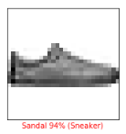
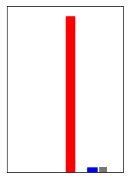
Output analyzing
When we classify using keras, we can have the 10 outputs for each set of testing instances. The highest number makes the judgement about the actual class.
There is a code uploaded on Canvas that can show you the output:
predictions = model.predict(X_test)
predictions[0]

Slide 21
Assignment 4
For this example please work on Fashion MNIST dataset:
Learning curves has an important role in developing any machine learning algorithm. To understand the effect of changing the hyper parameters and their effect on deep network that we designed, draw two learning curves for Accuracy of test vs. epochs (whereas number of epochs is 65). Repeat this analysis twice:
With Adam algorithm
With SGD

